Slide 1


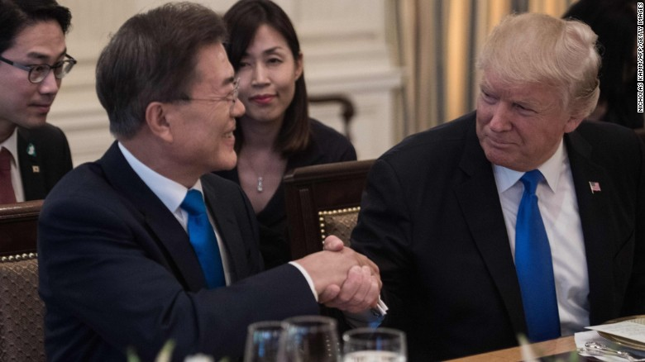
1 Month in Green Lab
Keltin Grimes

Slide 2
Project Introduction
Goal: To create a photocatalyst capable of converting sunlight and CO₂ into hydrocarbon fuels at industrial-level efficiencies
When exposed to light, semiconductors create an electron-hole pair
With the right synthesis and addition of co-catalysts, the pairs can split CO₂ and H₂O molecules which recombine into molecules like methane or ethane
Recent group publications in EES and Materials Today

Slide 3
Daily Tasks
Photocatalytic Tests Using GC
Most days
Purge the sample
Use the software under Saurav’s guidance
BT Synthesis
Last couple of weeks
Observe Ali mixing the samples in glove box
Do small tasks like nitrogen gun, washing, etc.
Helped Ali wash the samples in centrifuge

Slide 4
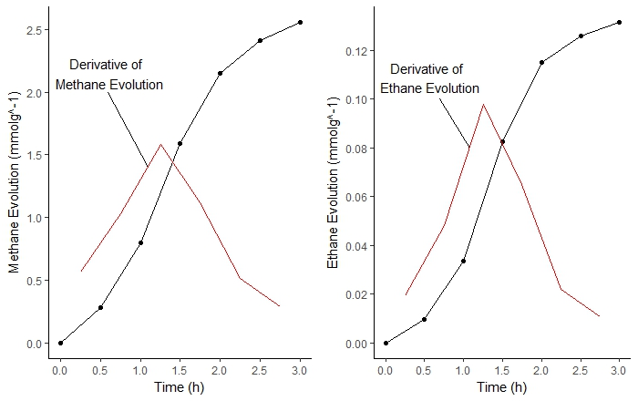
Research
Dr. Grimes thought to take derivative of product evolution
Distinct peak and subsequent drop
Cu_{1.00%}-Pt_{0.35%}-BT Sample

Slide 5
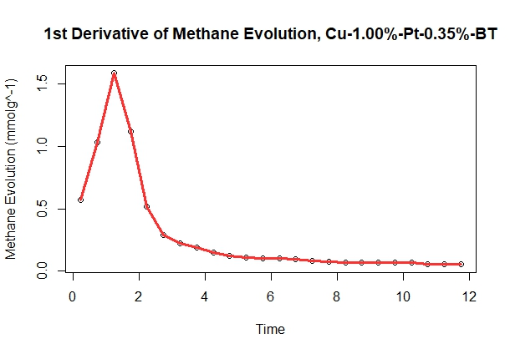
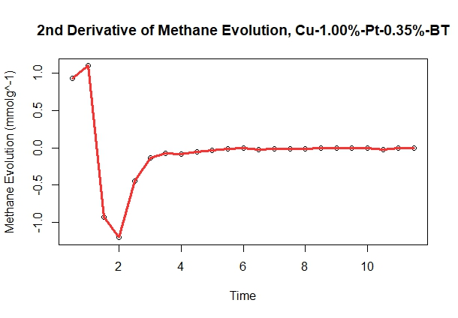
Research
Now we look at the second derivative
Clearly, whatever is happening has a huge impact but occurs very quickly
Three Stages: Activation, rapid deactivation, slow linear deactivation

Slide 6
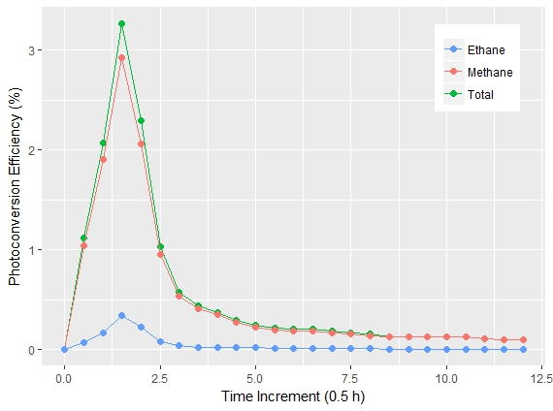
Research
Previously had been calculating net efficiency
Can be done incrementally
Peak and drop continues
Efficiency of Cu_{1.00%}-Pt_{0.35%}-BT Sample

Slide 7
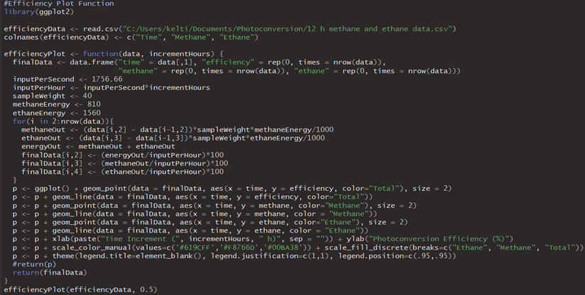
Research
Automated the plotting and calculation process using R

Slide 8
Research
Drop is clearly due to deactivation of photocatalyst
Can we quantify the deactivation process, how does the addition of co-catalysts affect it, and what can we do to prevent it?
Efficiency of Cu_{1.00%}-Pt_{0.35%}-BT Sample
Peak – 1hr: 67.39% Loss (Methane Only)
1hr – 2hr: 56.66% Loss (Methane Only)
2hr – 3hr: 33.06% Loss (Methane Only)

Slide 9
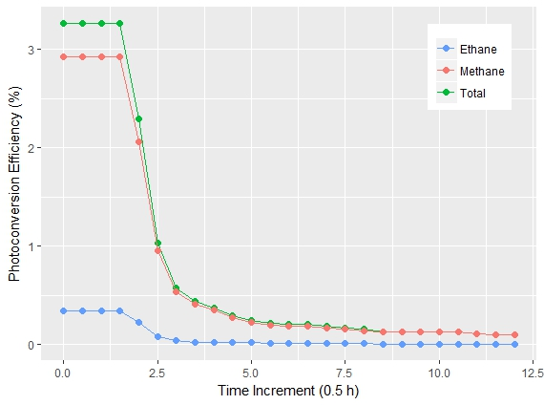
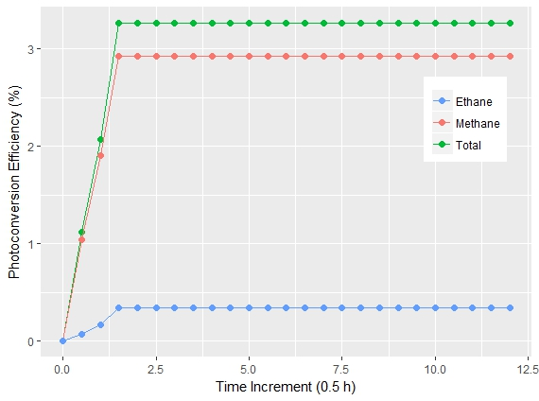
Research
Another problem is the slow activation of the sample
If we can quickly identify a way to give the sample a ‘hot-start’, that is great, but our efforts should be focused on preventing deactivation
Efficiency of Cu_{1.00%}-Pt_{0.35%}-BT Sample
0.576%
0.715%
3.127%
Actual Data:
3.44135 mmol Methane
0.15802 mmol Ethane
Ideal Hot-Start Scenario:
4.22402 mmol Methane
0.22223 mmol Ethane
Ideal No-Deactivation Scenario: 18.20805 mmol Methane
1.10939 mmol Ethane

Slide 10
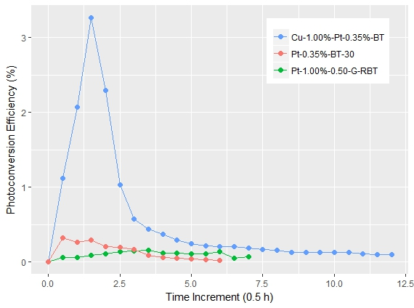
Research
Gathered data from multiple samples and papers
Again automated the calculations and plotting

Slide 11
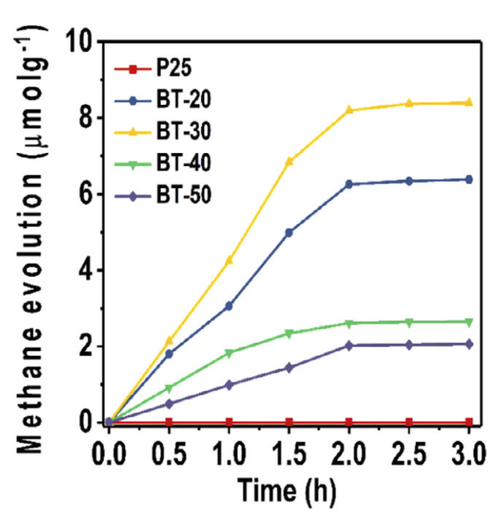
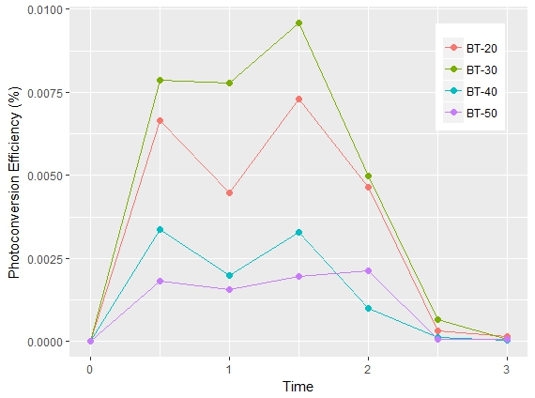
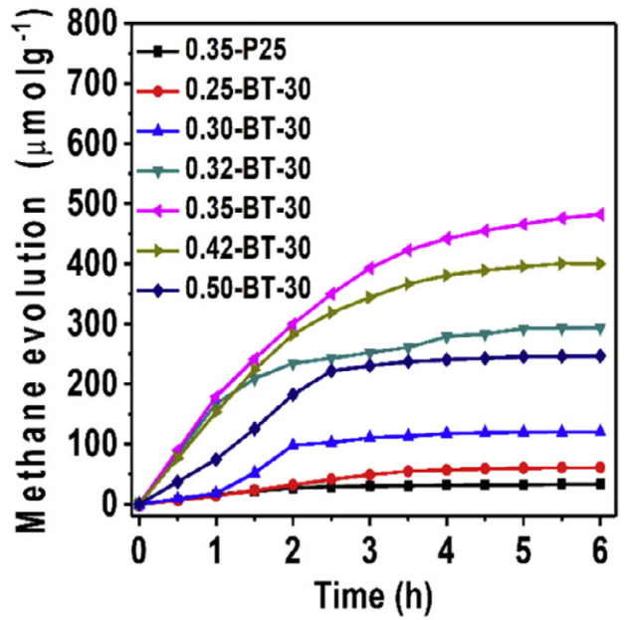
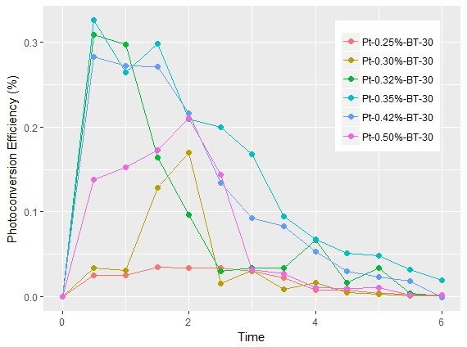
Research
Dramatic peak drop-offs with only BT or Pt and BT
Sorcar et al. Highly enhanced and stable activity of defect-induced titania nanoparticles for solar light-driven CO2 reduction into CH4. Materials Today 20, 507-515 (2017).

Slide 12
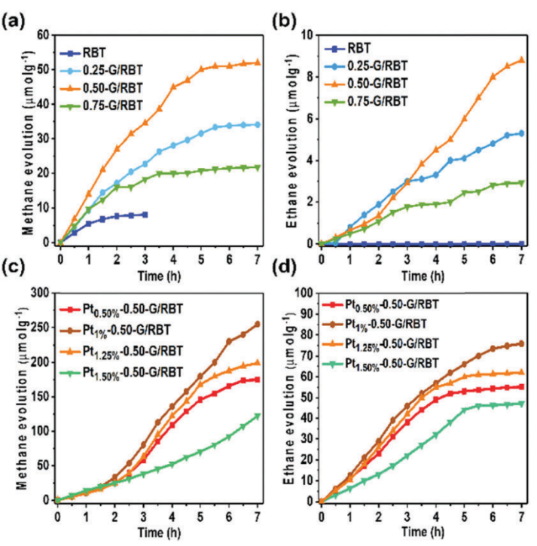
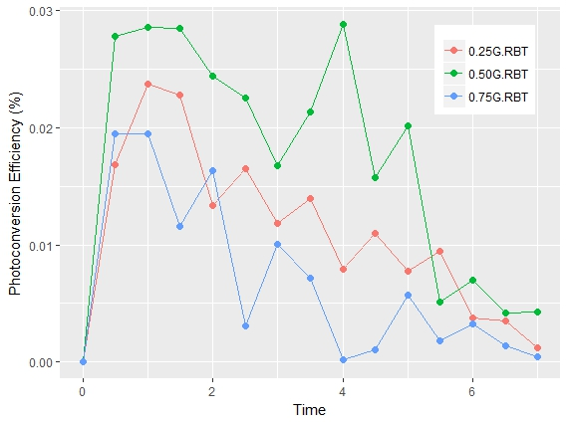
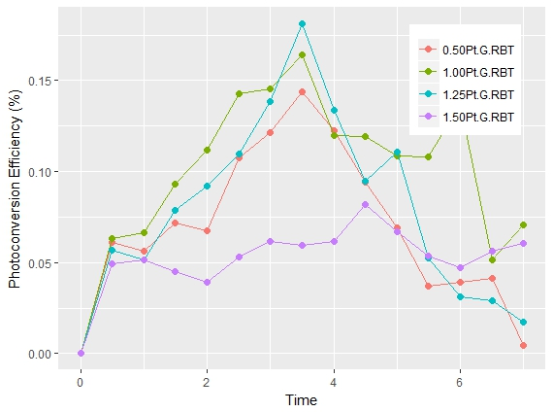
Research
Peak-drop offs are slower with G-RBT and peaks occur later with Pt-G-RBT
Sorcar et al. High-rate solar-light photoconversion of CO2 to fuel: controllable transformation from C1 to C2 products. EES (2018).

Slide 13
Research
Investigations like these seem to be uncommon
Continuing to look at the data in this way can provide good insights in how to prevent deactivation in the future

Slide 14
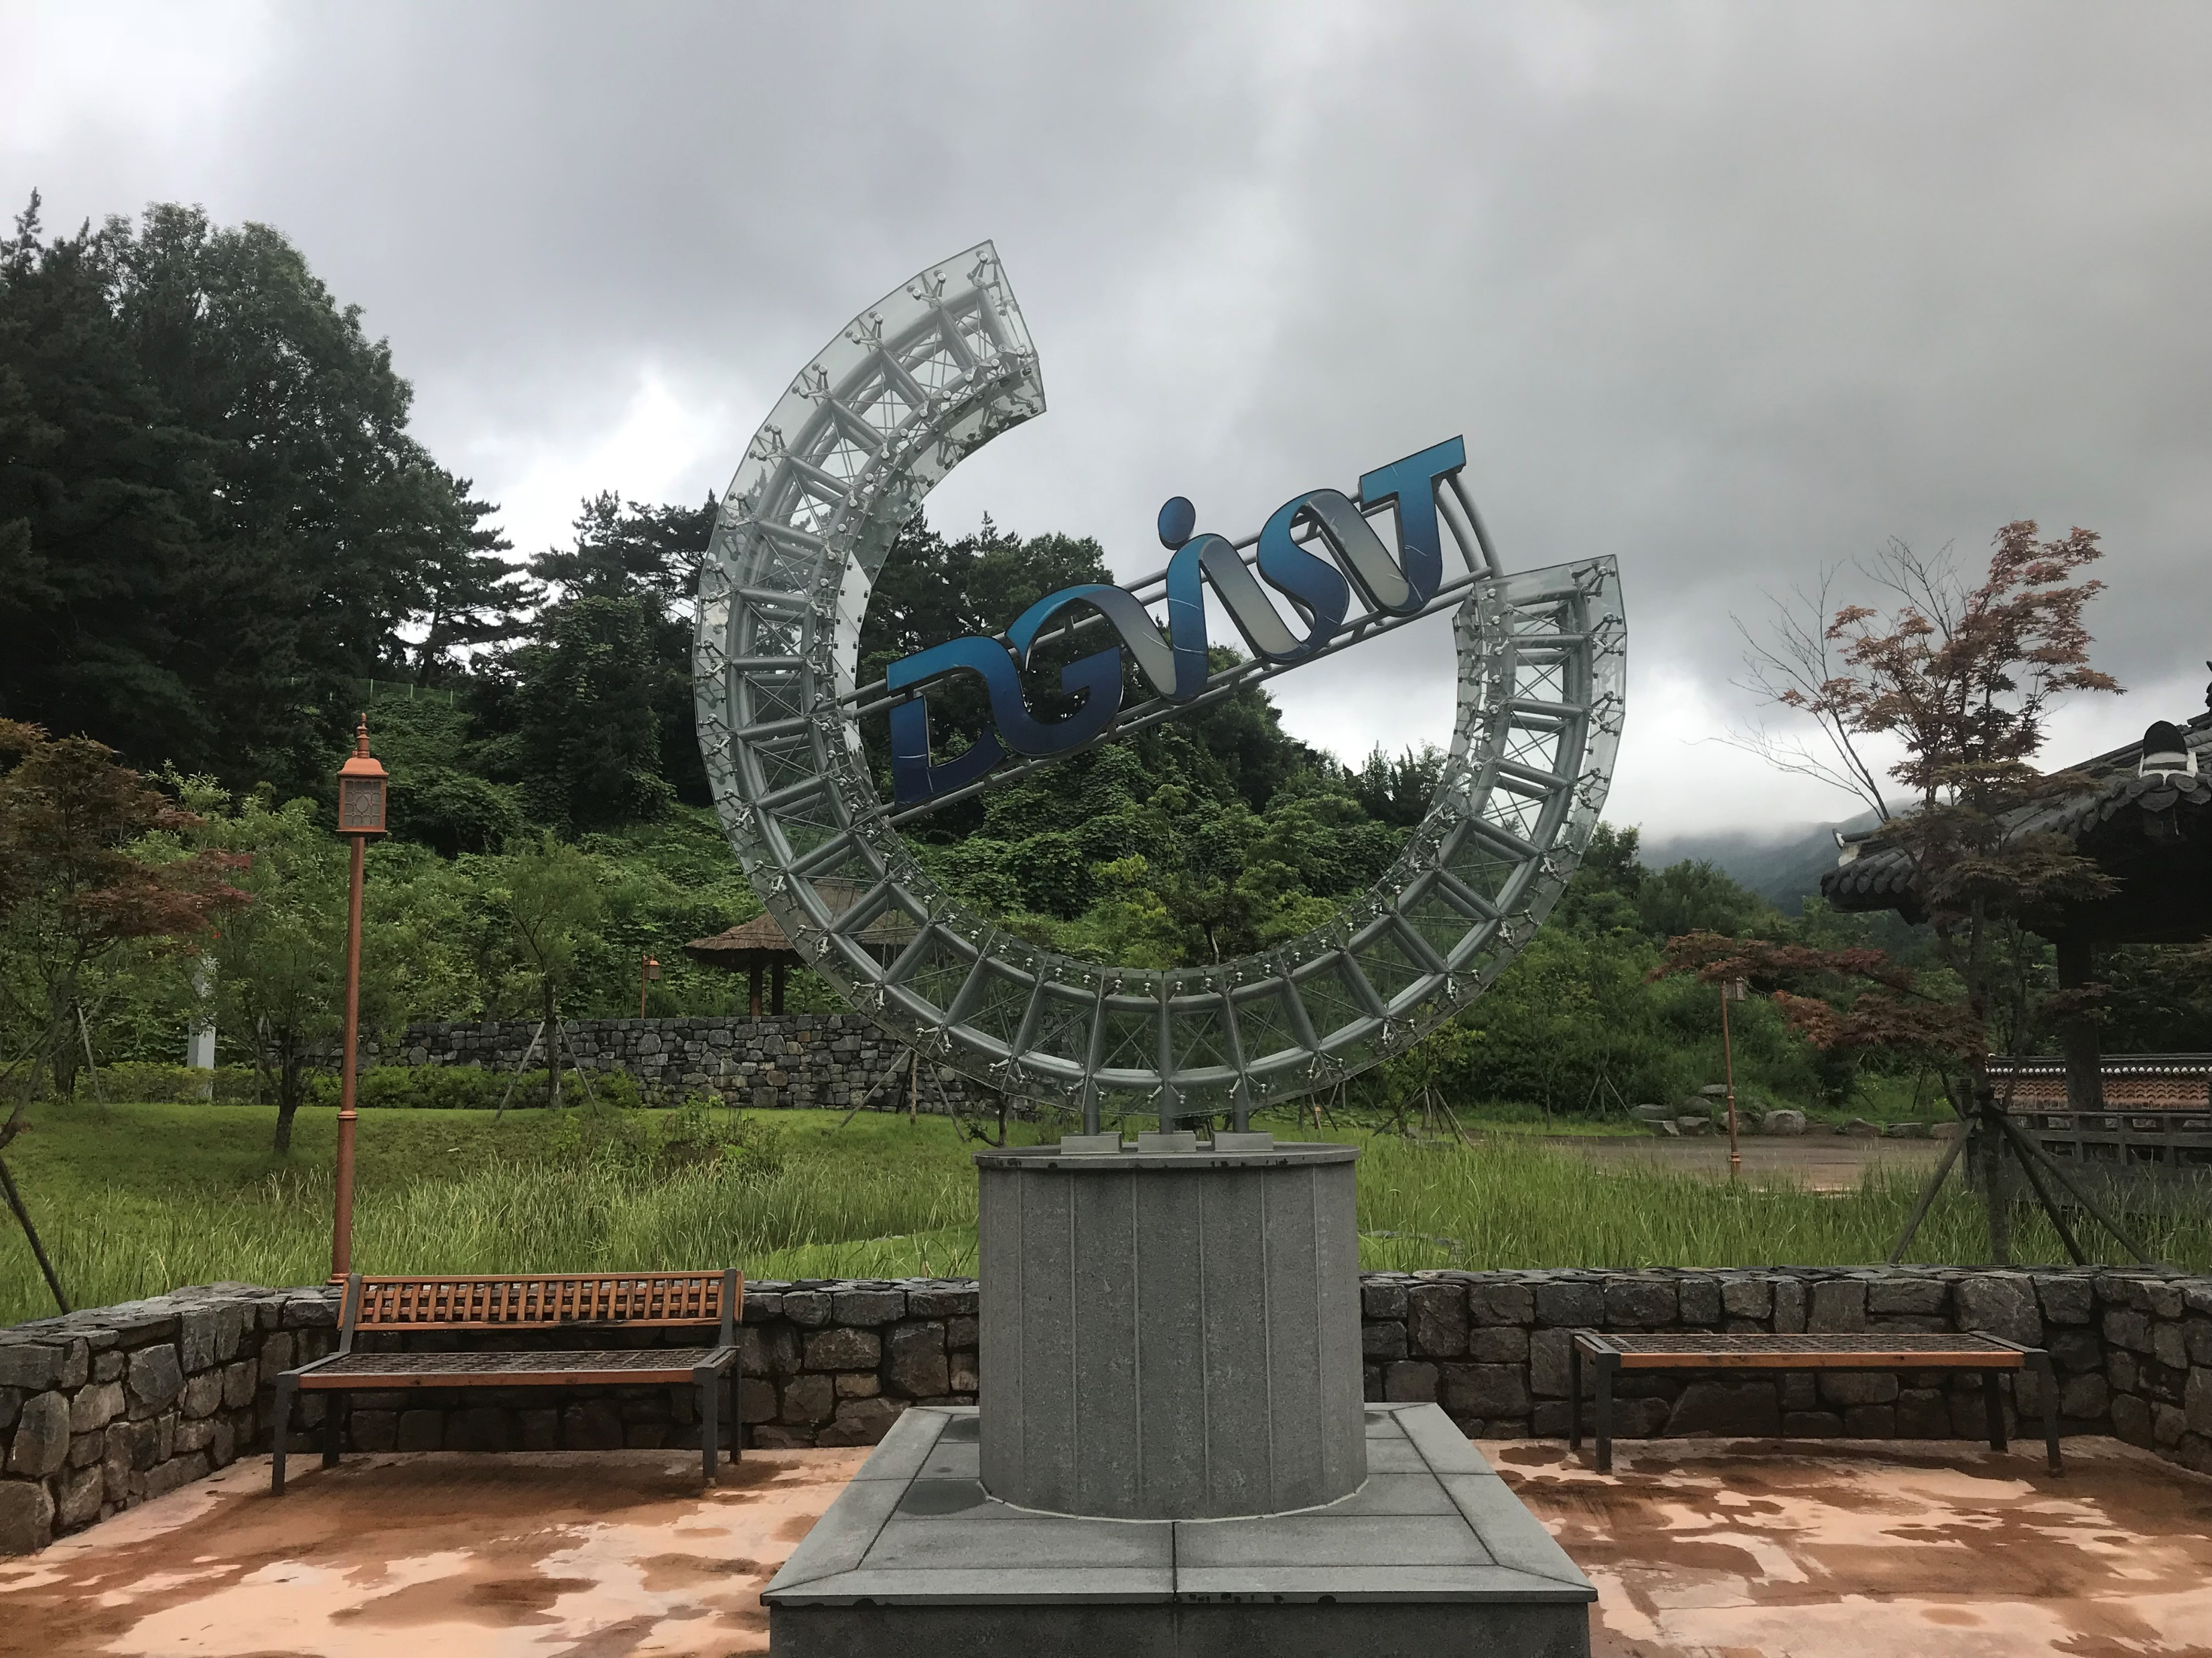
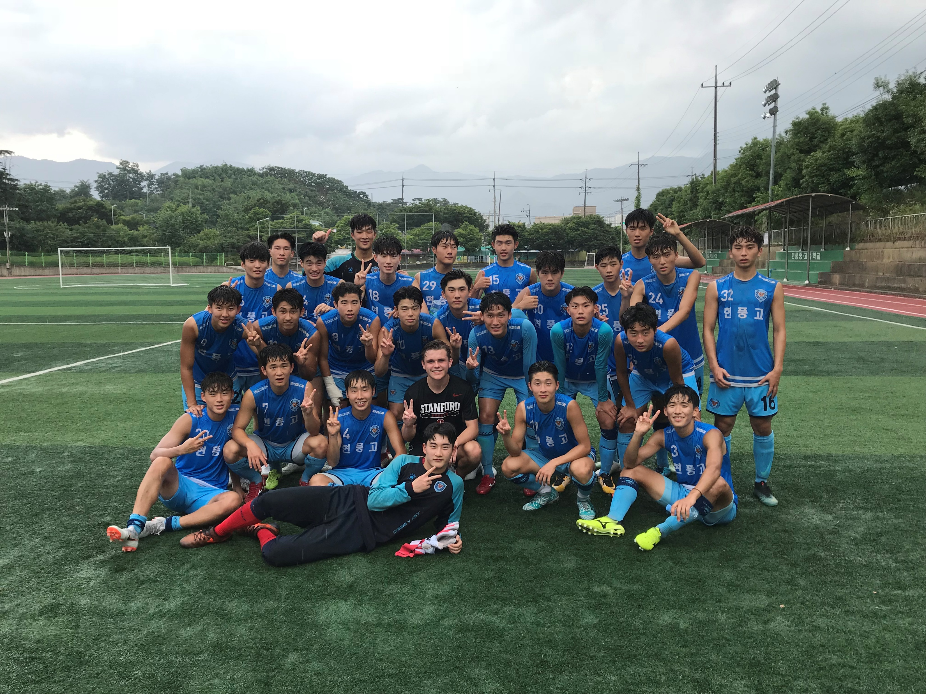
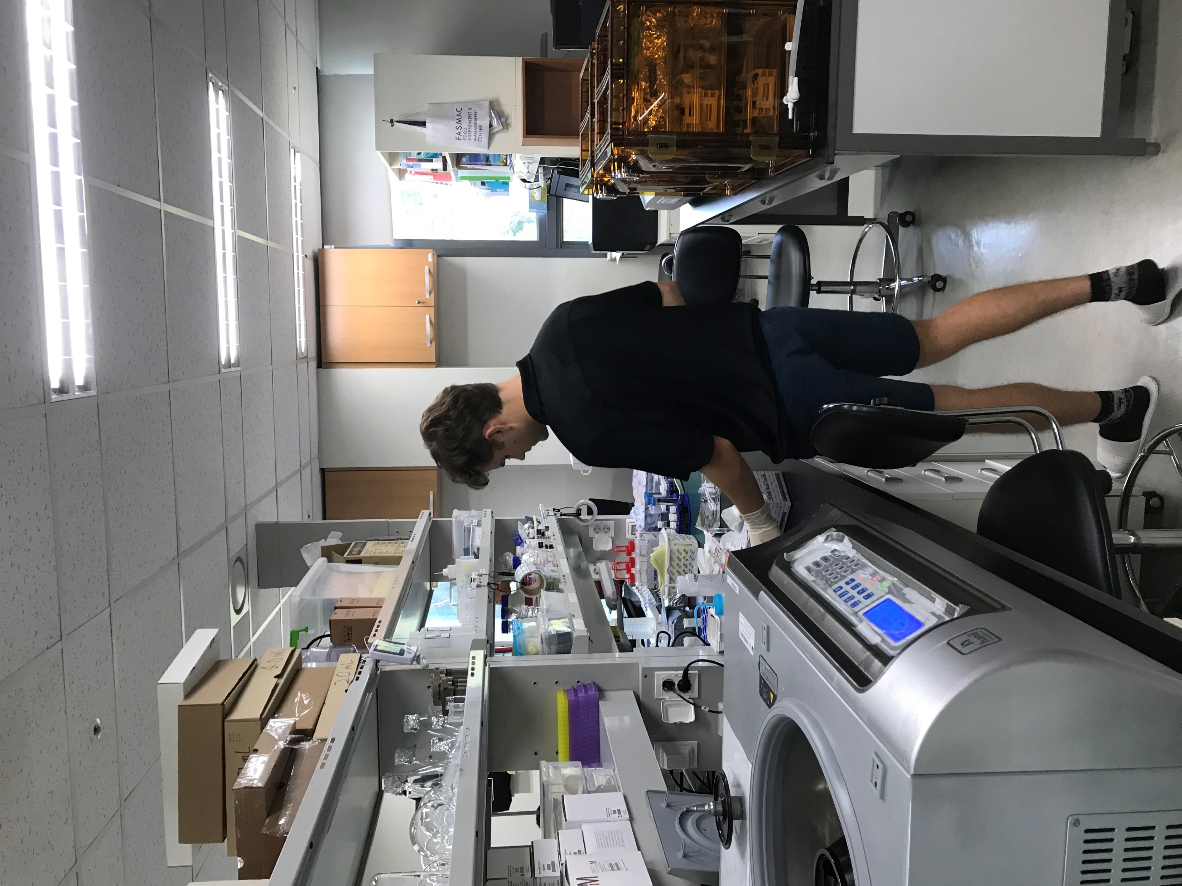
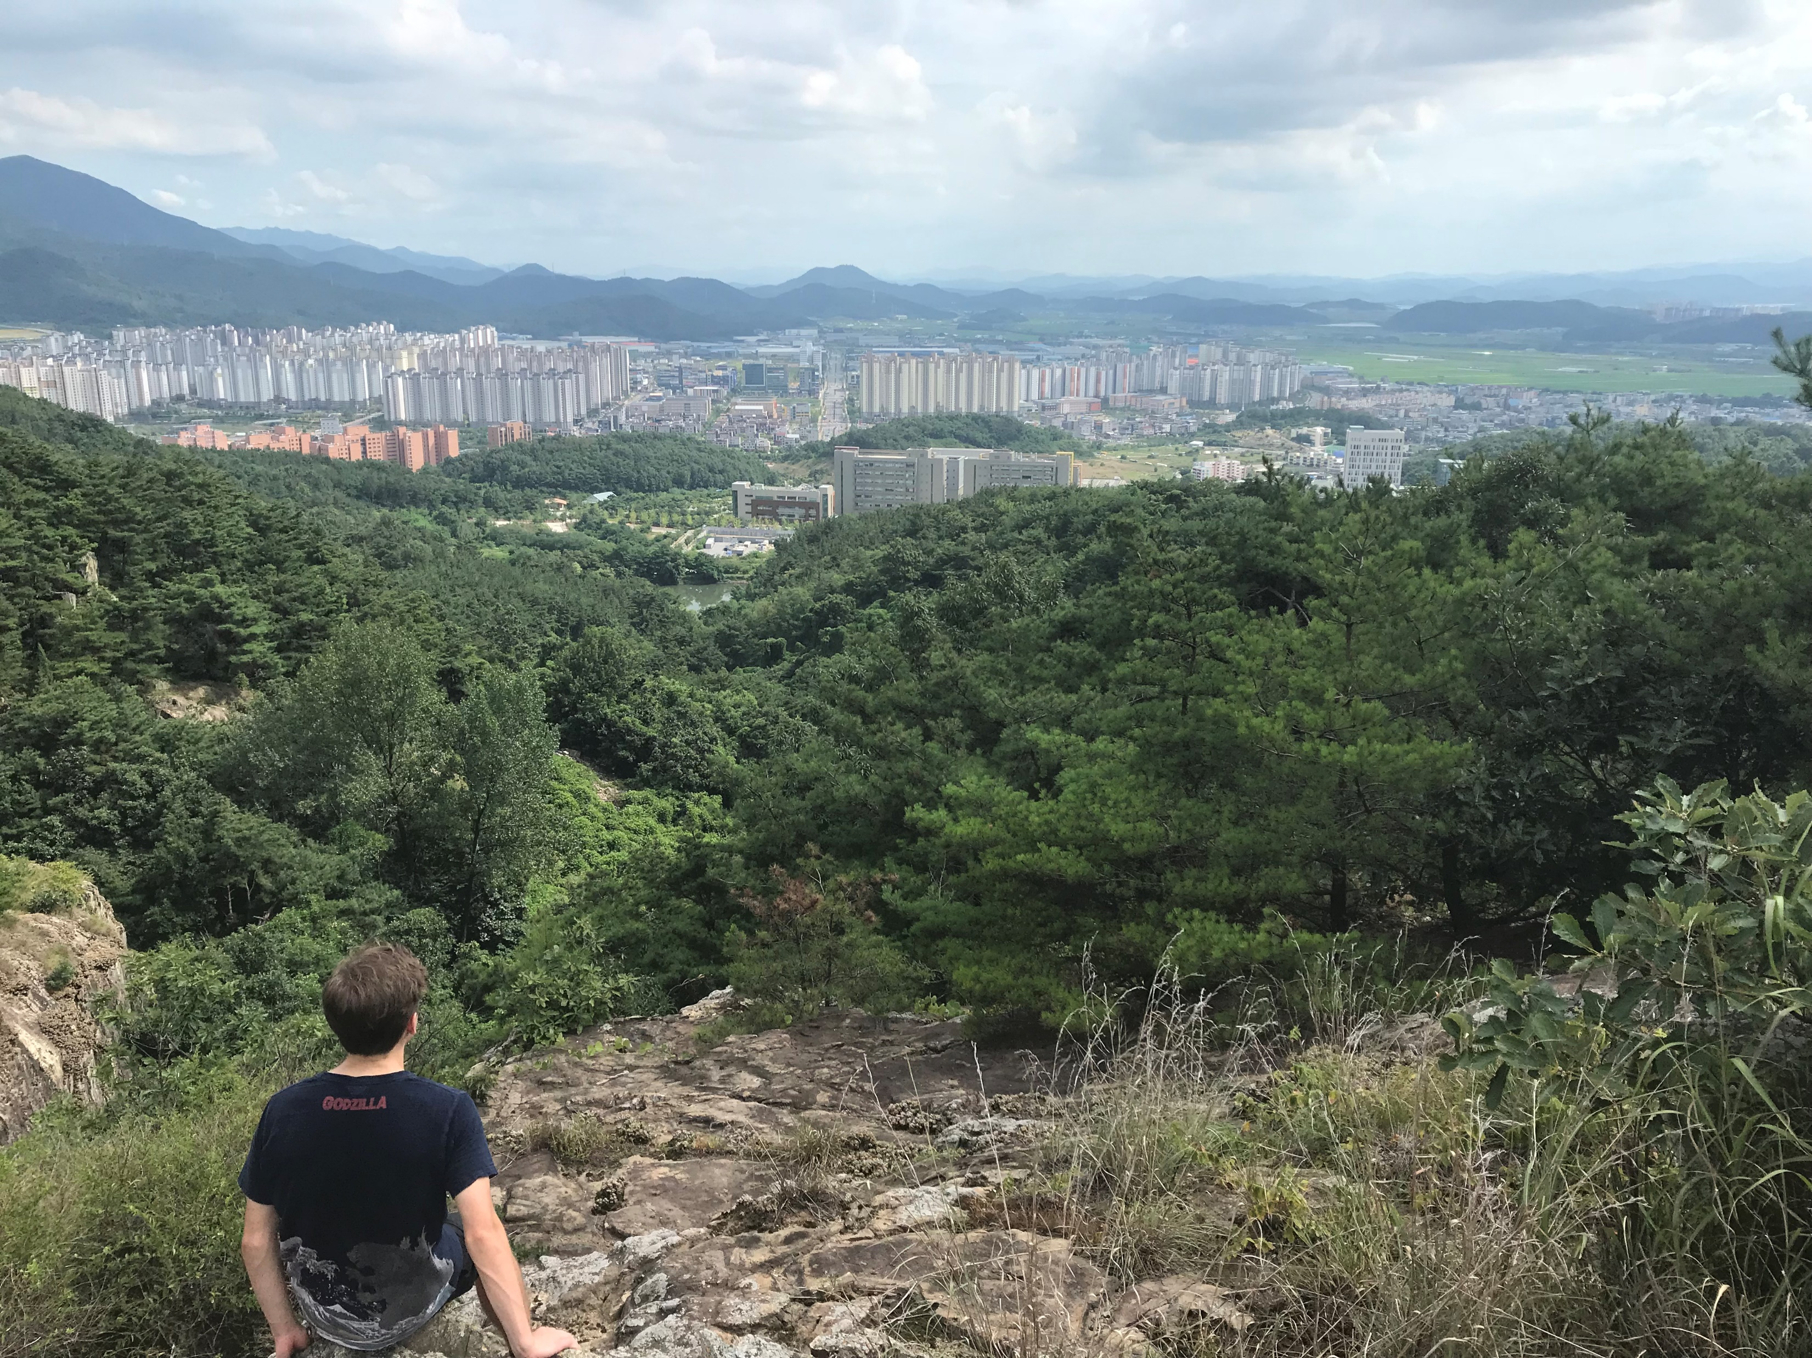
Memories
Working in the lab, DGIST campus, soccer

Slide 15
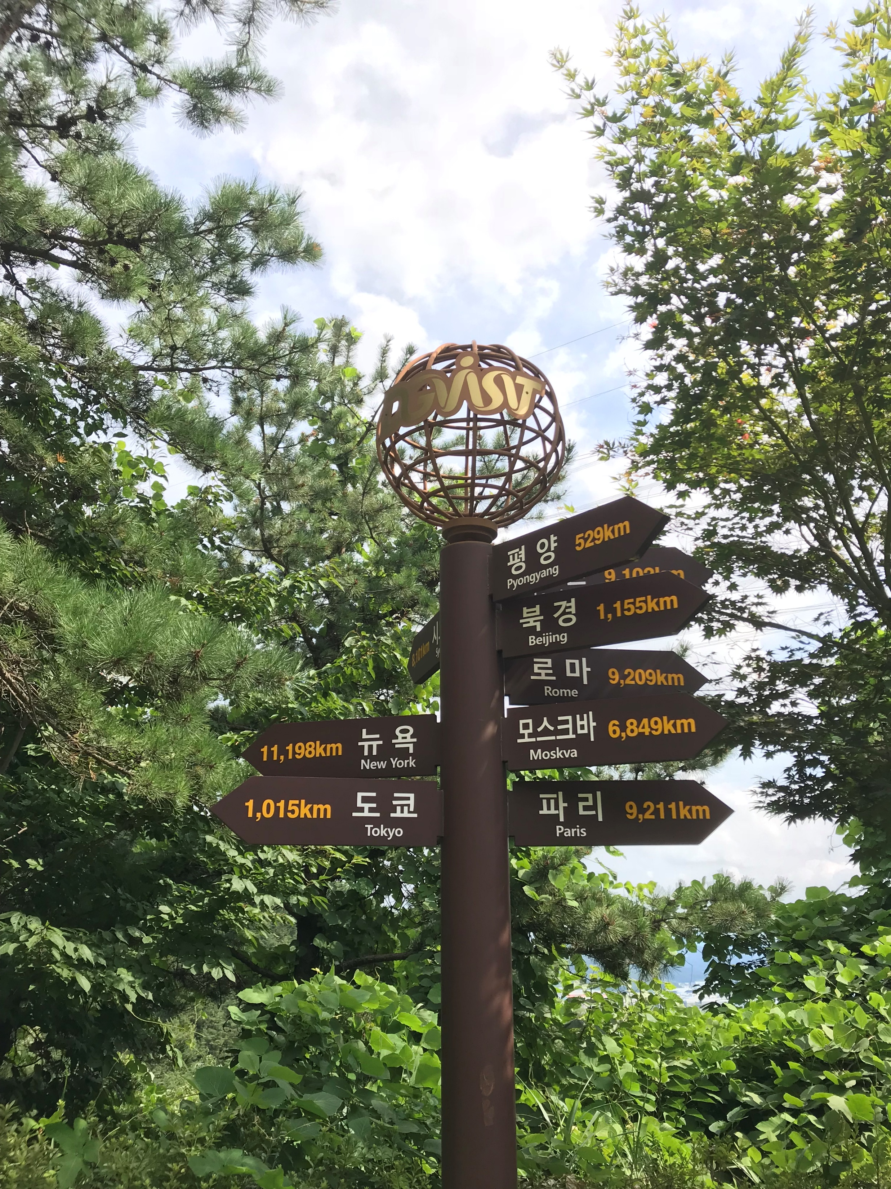
Thank You!
Dr. In for allowing me to work in your lab
Saurav and Ali for teaching me so much
EunHee for taking us to lunch every day
And everyone for being such gracious hosts!

